Slide 1
The design of HidrateSpark.com
By Joshua Miller

Slide 2
Background information
What is HidrateSpark.com?
HidrateSpark.com is a website owned and operated by the HidrateSpark company.
They sell smart water bottles to help remind people to drink water.
They have 13 different water bottles with many colors to choose from and many accessories.
Created in 2014 to help people develop healthy habits.
They claim %75 percent of americans are dehydrated even though they have enough water.

Slide 3

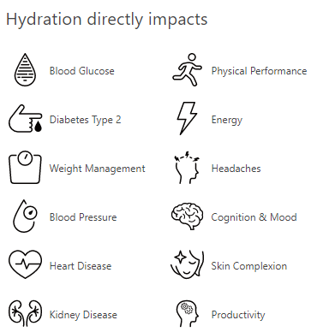
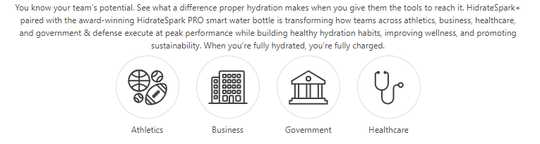
User Base
Who are they targeting?
People with health problems.
People who work in the healthcare business.
Athletes.
Americans.
All ages.
People with diabetes.

Slide 4
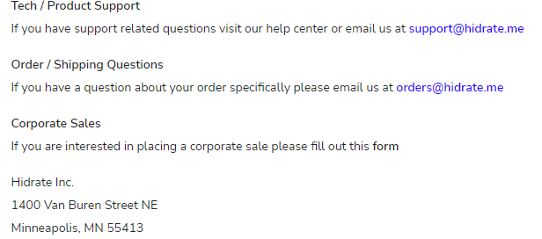
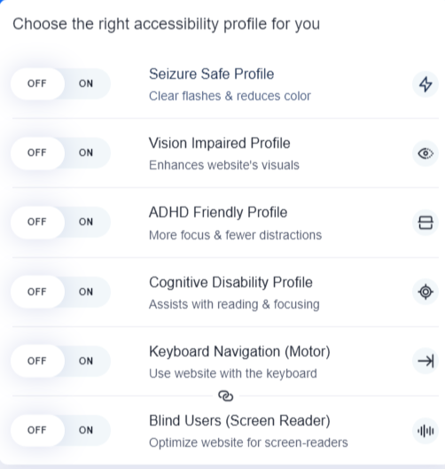
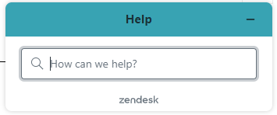

Accessibility Design
Pros -
A place to ask for help.
Multiple ways to contact them.
Apps and website for different platforms.
Easy to navigate.
Many accessibility options.
Cons -
Can’t find any other languages.
No color blind support.

Slide 5
User
Flow

Slide 6
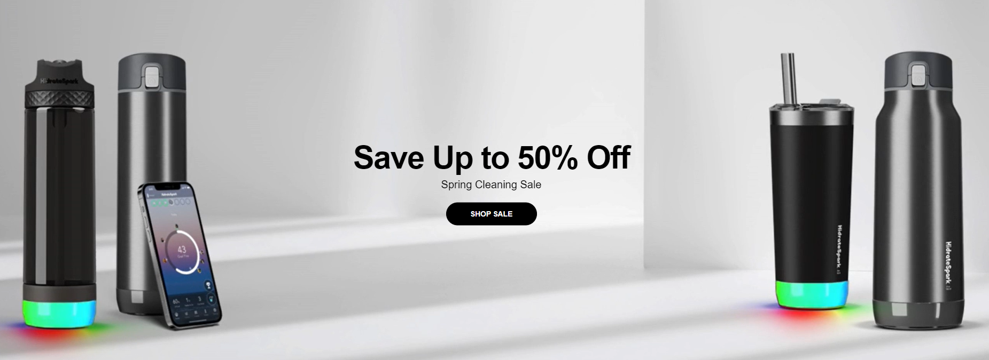
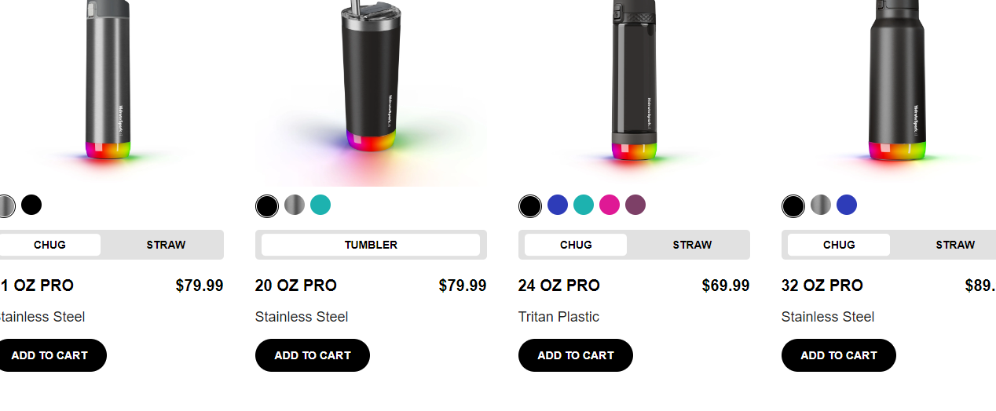
Website Homepage Design
Eye catching with many different colors and animations.
Informative with many reasons to buy the product.
Easy to read and understand.
Not overwhelming with too much information.
Able to add to cart directly from homepage.

Slide 7
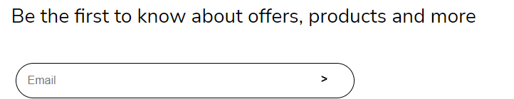
Sign Up Process
You only need to sign up if you want to know more about the products.
If you want you can sign up for Hidrate Spark that allows for extra features.

Slide 8
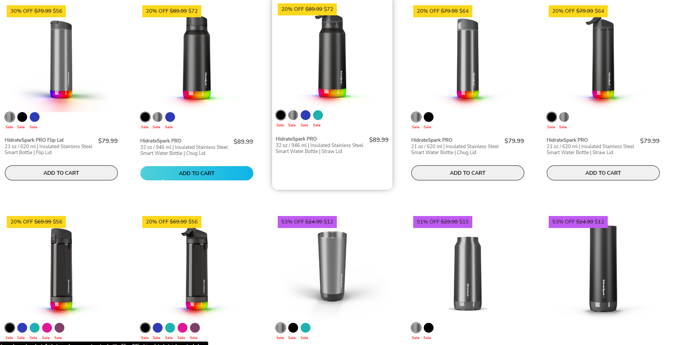
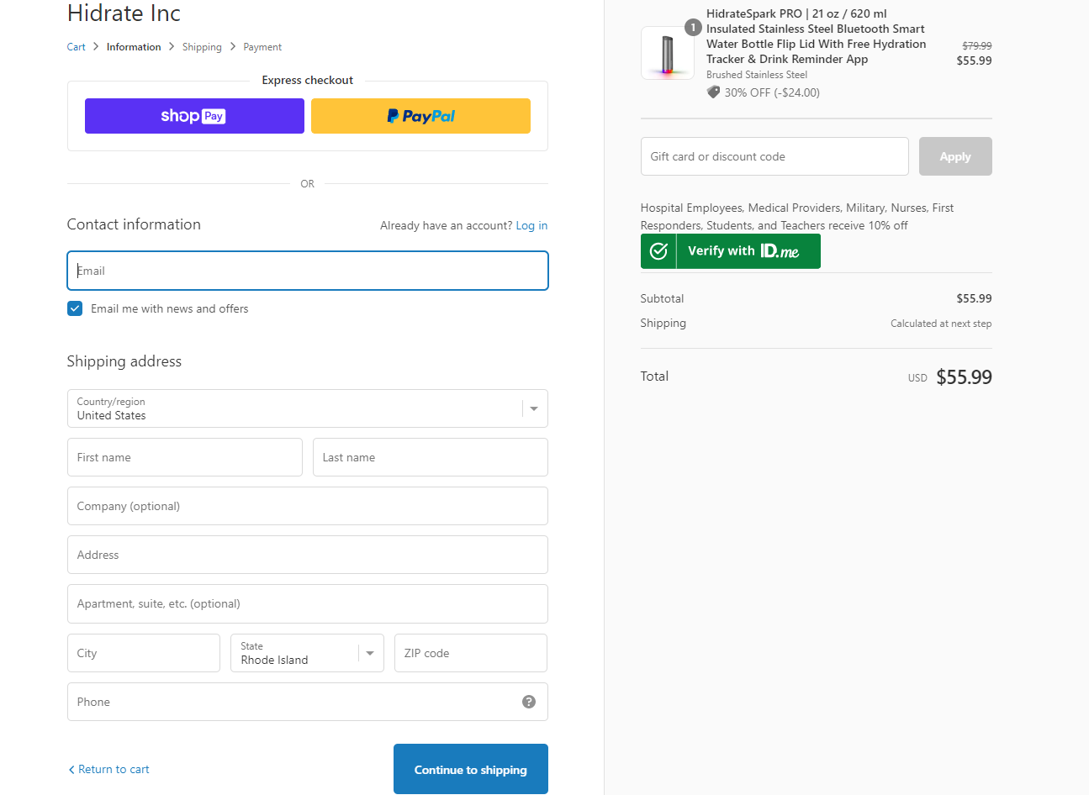
Payment experience
Many different water bottles to choose from.
Ability to purchase gift cards.
Easy to fill out and secure.
Prices range from $50-$100

Slide 9
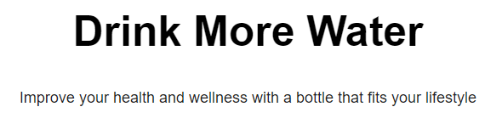
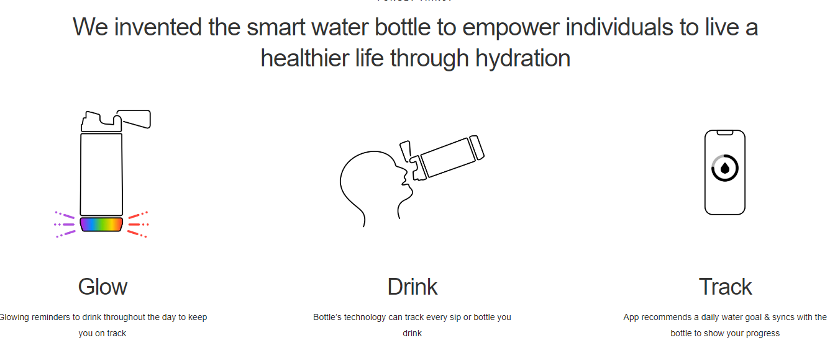
Key Takeaways
Many useful accessibility options.
Large user base.
Simple and easy to understand design.
Easy to buy without problems.
Supports multiple payment methods.
Optional dark mode.
Eye Catching colors and animations.
Short but informative texts.

Slide 10
Work Cited.
https://hidratespark.com

Slide 11
Thank you!

